Slide 1

BMS INSTITUTE OF TECHNOLOGY & MANAGEMENT, YELAHANKA, BANGALORE. Department of Computer Science & Engineering
NEURAL DEVELOPMENTAL INTELLIGENT SYSTEM
Adarsh Kumar Sah (1BY15CS006)
Bhargav Sagiraju (1BY15CS016)
Chandrashekar S (1BY15CS020)
Under the guidance of
Dr. THIPPESWAMY.G
Professor and HOD of CSE Department

Slide 2
ABSTRACT
Any system which claims to be powered by Artificial Intelligence or NLP or Neural Network human like behaviour is achieved through Reinforced Learning which allows the system to make calculated decisions.
The term Neural Network refers to a specific type of paradigm that emulates the way synapses work in your brain.
Many of the smart systems incorporate functions of sensing, actuation, and control in order to describe and analyse a situation.
Hence the motivation to develop an intelligent system using advanced learning algorithms becomes today’s necessity.

Slide 3
OBJECTIVE
To train a model to make a sequence of decisions from the provided environment, the system uses reinforcement learning to employ all the trials and errors to come up with the emotion based solution.
The goal is to maximize the overall efficiency of giving the smart results for user queries, by analysing the state of user and extracting features and by rewards or penalties for every iteration of user input
Neural Developmental Intelligent System 4

Slide 4
INNOVATION
A Computerized AI that tries and succeeds in representing, reasoning about the various events, and interpreting the data.
Learns about the structure of the data, analyses the data to extract patterns and meaning, derive new information, and identify strategies and behaviors to act on the results of its analysis through reinforced learning methods.
The system comes in a single form and aims to work using integrated modules in the Offline Mode and has many directions, from controlling the situation-based answering considering facts, detecting the various emotions in text and possibly speech to processing huge data sets.

Slide 5
PROPOSED METHODOLOGY
To compare the performance of the proposed system, multiple initial simulation of problems will be executed. The goal is to recognise the user query with maximum accuracy and respond accordingly, with related emotions and the adaption to the previous corrected user queries.
The number of steps varies as the simulations are preformed and the semi supervised and supervised algorithm to derive the results and store them to the checkpoints database as a reward. The decisions will be made according to the steps proposed by the algorithm.
Neural Developmental Intelligent System 8

Slide 6
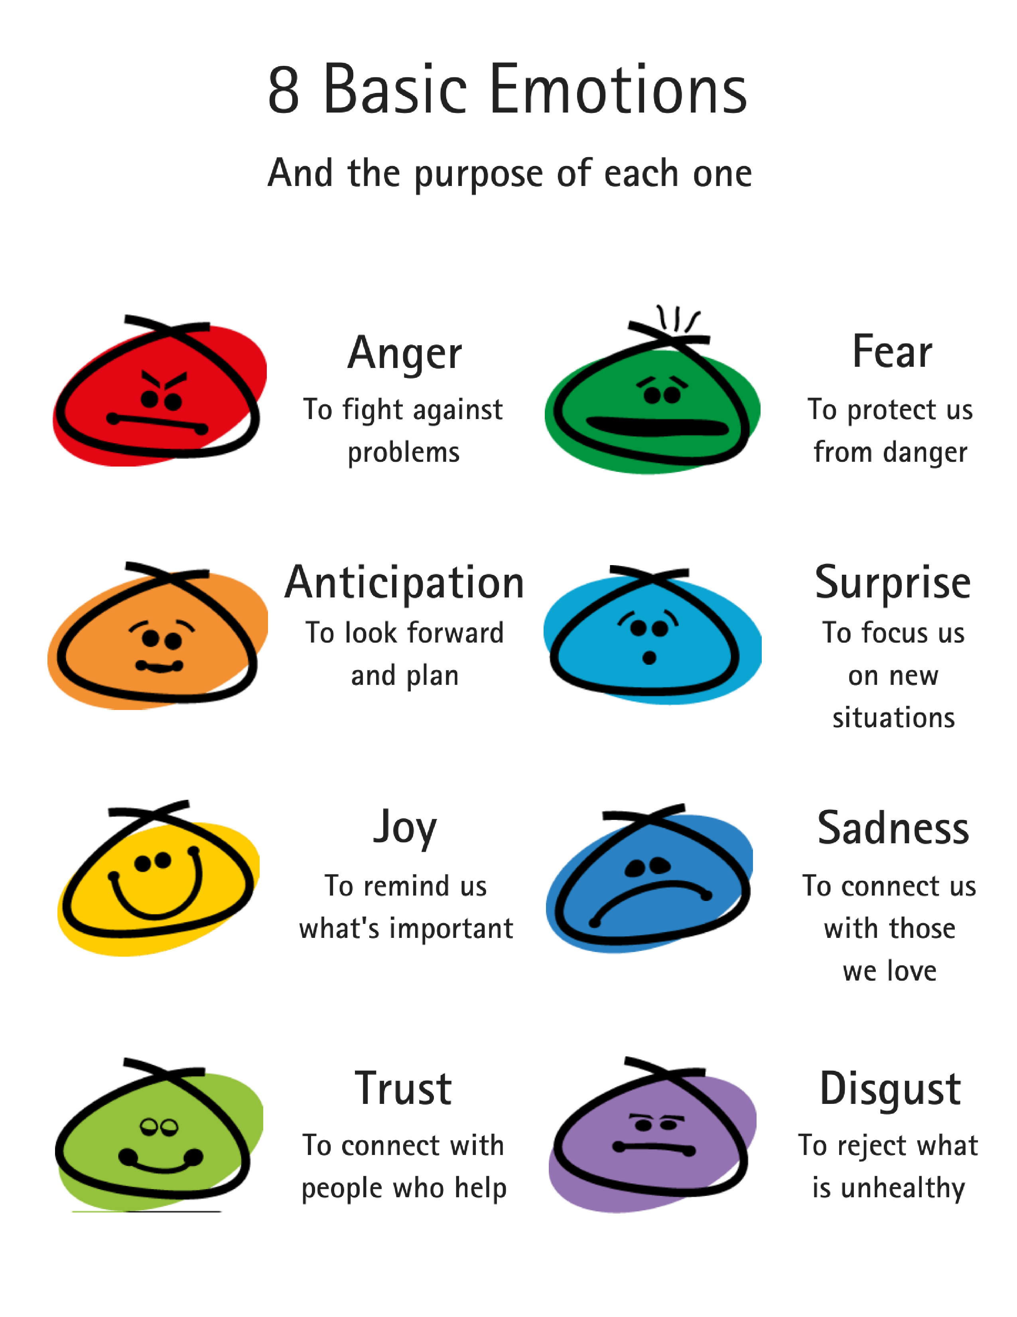
PROPOSED SYSTEM
Emotion Types:
The purpose of this system is to cover the foundational theories, methods, and supervised, semi-supervised algorithms and technologies involved in artificial intelligence.
Modelling and building systems that can reason, solve problems, acquire and use knowledge, make decisions, and communicate in natural language.
Introduction of the science and engineering of intelligent systems, including the correspondence with natural cognitive systems and the design of smart tools acts as the primary purpose of this system.

Slide 7
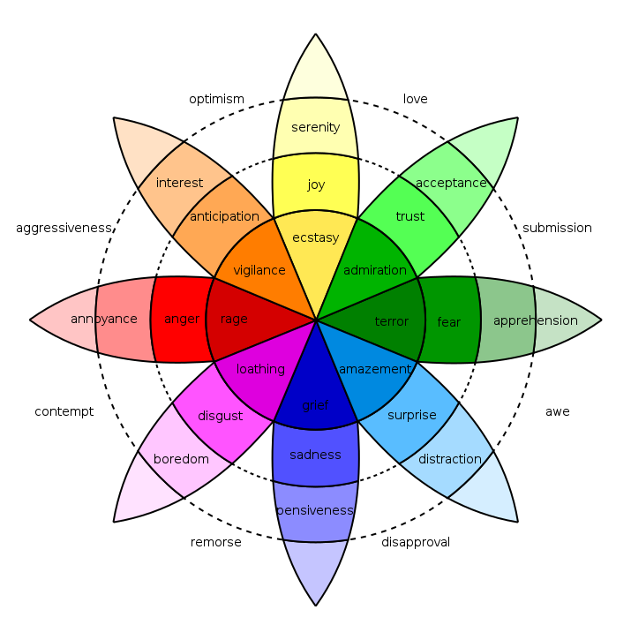
PLUTCHIK’S WHEEL OF EMOTIONS

Slide 8
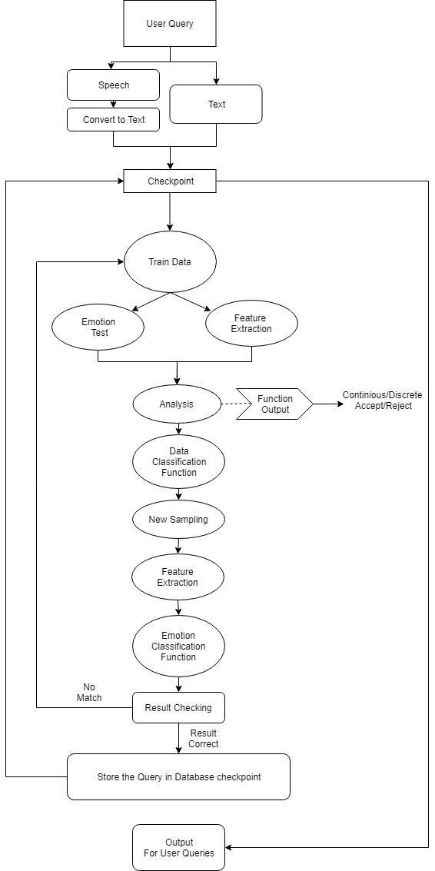
FLOW DIAGRAM
Neural Developmental Intelligent System 9

Slide 9
EXPECTED OUTCOMES
The system is expected to make a clear-cut predictions and finding the optimal mapping of morphemes and identifying the class of morphemes.
It makes sure that every bit of user query is processed and based on the training, the emotion is derived and respond to the user in minimal time, with smart suggestions/ requirements
Neural Developmental Intelligent System 10

Slide 10
APPLICATION
This system can be used in several fields such as healthcare, general user interactions and monitoring, customer service and other areas where communication is essential.
The system can also learn from user habits and produce suggestions to the user, this allows for more personalised usage.
The system can have several integrations with Raspberry Pi and Intel Movidius to have life long learning to continue making decisions and learn according to patterns.

Slide 11
RELEVANCE TO INDUSTRY
Existing systems must be connected to the internet and has limited activity offline. Our system removes this need by staying offline.
Most intelligent agents available today do not contain emotion based decisive or chat systems which enable offline chat for personalization. Emotion based detection would play a better role in complete interaction.
Mimic disintegration is defined as the inability to organize specific speech states as an integrated whole, thus making it difficult for observers to decode the emotional state and establish contact or develop a relationship.
Humans show universal consistency in recognising emotions but also show a great deal of variability between individuals in their abilities, this need to identify emotions will be reduced by the machine by using the emotion classification.
Neural Developmental Intelligent System 6

Slide 12
BUDGET
Factors | Amount
a) Materials / Consumables | 10000.00
b) Labour | 0.00
c) Travel | 0.00
d) Report | 700.00
e) Miscellaneous | 0.00
Total | 10700.00

Slide 13
REFERENCES
[1] Peng Zhou, Wei Shi, Jun Tian, Zhenyu Qi, Bingchen Li, Hongwei Hao, Bo Xu 2013, Attention-Based Bidirectional Long Short-Term Memory Networks for Relation Classification.
[2] Jeffrey Pennington, Richard Socher, Christopher D. Manning 2014, GloVe: Global Vectors for Word Representation.
[3] Erik Tromp, Mykola Pechenizkiy 2014, Rule-based Emotion Detection on Social Media: Putting Tweets on Plutchik’s Wheel.
[4] Benaissa Azzeddine Rachid, Harbaoui Azza and Ben Ghezala Henda 2018, Sentiment Analysis Approaches based on Granularity Levels.
[5] R.Anish Menon, Anurag De, B.Priyanka Reddy, B.Sukanya 2016, Various approaches for human emotion recognition: a study.
[6] Jelena Milosevic, Dexmont Pe˜na, Andrew Forembsky, David Moloney 2018, Reporting Accuracy, Inference Time and Power Consumption for Face Emotion Recognition on Embedded Systems.
[7] Guillaume Daval-Frerot, Abdessalam Bouchekif, Anatole Moreau 2018, Epita at SemEval-2018 Task 1: Sentiment Analysis Using Transfer Learning Approach.

Slide 14
REFERENCES
[8] A. Kalyani, B. Premalatha, K.Ravi kiran 2018, Real Time Emotion Recognition from Facial Images using Raspberry Pi.
[9] David Zimbra, Ahmed Abbasi, Daniel Zeng, Hsinchun Chen 2018, The State-of-the-Art in Twitter Sentiment Analysis: A Review and Benchmark Evaluation.
[10] R. Cowie, E. Douglas-Cowie, N. Tsapatsoulis, G. Votsis, S. Kollias, W. Fellenz, J.G.Taylor 2001, Emotion Recognition in Human-Computer Interaction.
[11] Abdalsamad Keramatfar, Hossein Amirkhani 2018, Bibliometrics of sentiment analysis literature.

